Slide 1
NATURE-INSPIRED ALGORITHMS FOR IMPROVING UNDERWATER OBJECT DETECTION
Final year BE Project-II, EXTC Dept., RAIT, 24, Apr 2023
Group - 13
Mr. Bhushan Mahajan (19ET1105)
Ms. Jui Mandkulkar (19ET1047)
Ms. Janhavee Kshirsagar (19ET1138)
Ms. Aditi Pawar (20ET5003)
under the guidance of
Asst. Prof. Pramod H. Kachare
Academic Year 2022-23

Slide 2
OVERVIEW
Research Objective
Introduction
Literature Review
Nature Inspired Algorithms
Observations
Database
Performance measures
Results
Future Plan

Slide 3
RESEARCH OBJECTIVE
To detect objects in underwater environment
To extracting feature encoding using open-source pre-trained NNs
To selecting salient features using Nature-inspired algorithms (NIA)
To compare computational advantage using various performance measures.

Slide 4
INTRODUCTION TO PROBLEM
Underwater object detection suffers from colour bias & low visibility, so it have poor quality.
Models reported in literature suffer from the curse of dimensionality.
NIA select salient task-specific features subset.
Deep learning (feature extractor) & NIA (feature selector) reduce the feature dimensionality while obtaining high performance in underwater object detection.

Slide 5
LITERATURE REVIEW
Han et al. (2020): Underwater image processing and object detection using Deep-CNN: 18000 images recorded by underwater robot, Max-RGB method, gray-shades method, CNN Method to solve weak illumination. CNN Network, S-1: convolution kernel (1, 1), S-2: append down-sampling layer. Accuracy CNN=70.33%, S1=84.59%, S2=87.42%.
Pan et al(2020): Multi-scale ResNet for real-time underwater object detection: Fish4 Knowledge Ground-Truth dataset, MResNet, FPN as feature extractor, mAP= 96.5% accuracy.
Kezebou et al.(2019): Underwater Object Tracking Benchmark & Dataset: Low quality of underwater data made it less attractive, advance in open air but less in underwater hence need to create benchmark.
Li et al. (2022): Yolov4 based underwater biological detection with channel attention: Brackish Dataset, 89 video clips with 25,613 annotations. CSPDarknet53 as feature extraction network. Yolov4. Channel attention mechanism. Average precision with 75% accuracy.

Slide 6
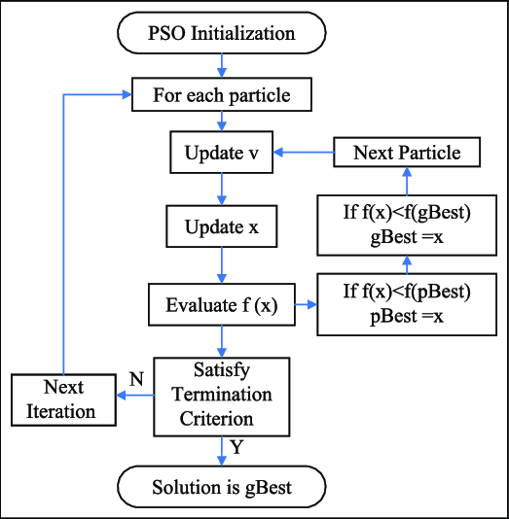
PARTICLE SWARM OPTIMIZATION (PSO) Kennedy et. al. (1995)
Population-based optimization
Motion of bird flocks & schooling fish.
social behaviour of flocks of birds.
Good exploration
Image Source : Abualigah,2016

Slide 7
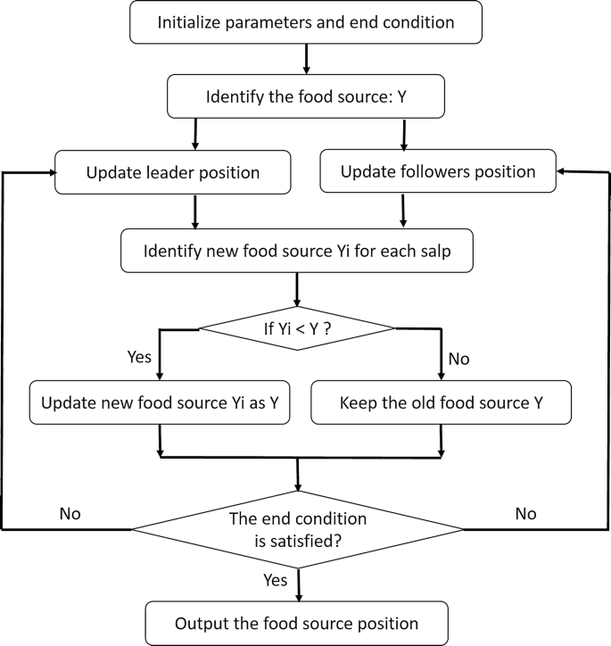
SALP SWARM ALGORITHM (SSA):Mirjaalili et al (2019)
Population (leader & followers) based optimization.
Swarming behavior of salps in oceans.
Solve complex daily life optimization problems in nature.
Good exploration
Image Source : Abualigah,2019

Slide 8
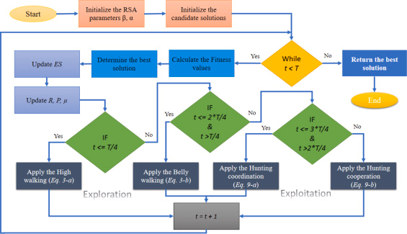
REPTILE SEARCH ALGORITHM (RSA): Abualiagah et.al. (2021)
Population-based optimization.
Hunting behaviour of reptiles.
Stimulates walking, coordination, and cooperation in hunting.
Good exploitation.
Image Source : Abualigah,2021

Slide 9
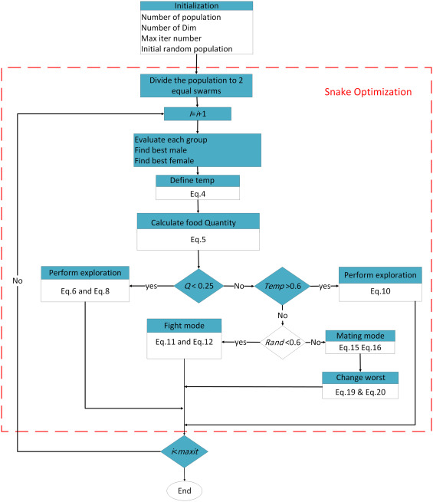
SNAKE OPTIMIZER (SO):Hashim et al (2022)
Intelligence-based optimization.
Mating behaviour of snakes.
Split population (male & female) to simulate fighting and mating modes.
Good exploitation.
Image source : Hashim,2022

Slide 10
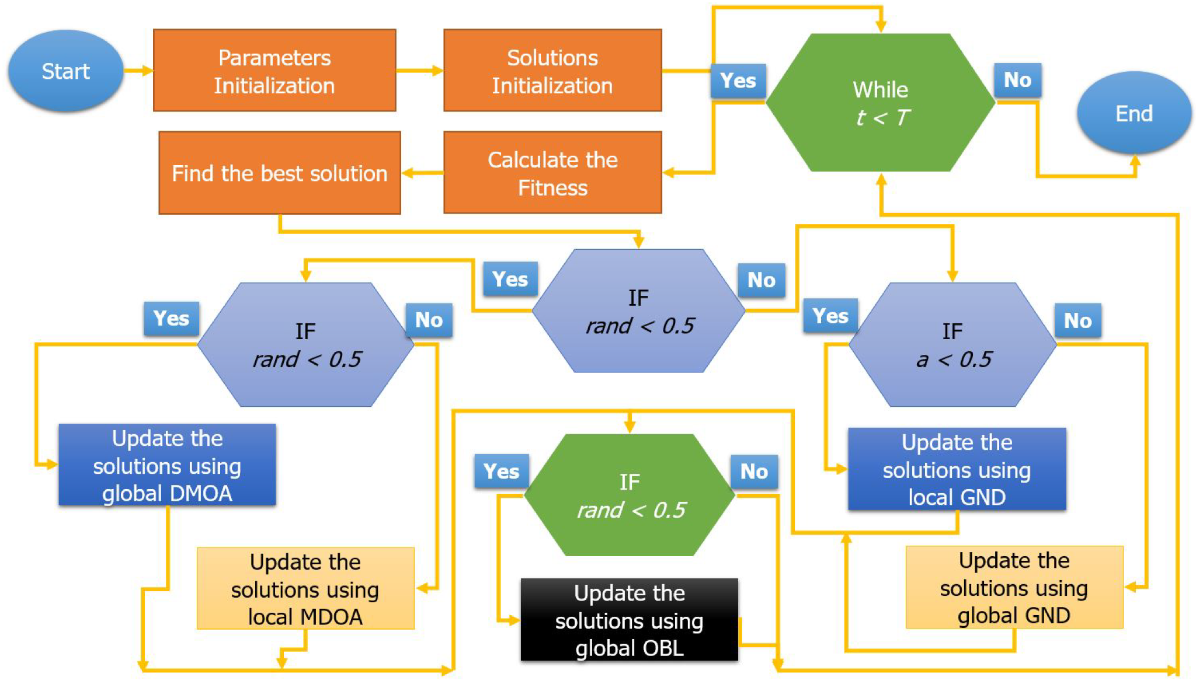
DWARF MONGOOSE OPTIMIZATION ALGORITHM (DMOA): Agushka et al(2022)
Population-based optimization
Foraging behaviour of dwarf mongoose.
Split population into alpha group, babysitters & scouts to simulate restrictive & catching modes.
Good exploitation.
Image source : Aldosari, 2022

Slide 11
FICK’S LAW ALGORITHM (FLA): Hashim et al. (2023)
intelligence based optimization
Fick’s first rule of diffusion.
Simulate diffusion phase, equilibrium phase, & steady state phase.
Good exploration & exploitation.

Slide 12
DATABASE
Parameter | UOT32 | UOT100
#Images | 24241 | 74042
#Videos (Class) | 32 | 104
Frame Rate | 29.15 | 26.2
Avg. #frames/video | 757.53 | 698
Dataset size (GB) | 3.76 | 6.26

Slide 13
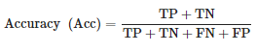
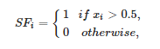
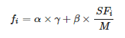
PERFORMANCE MEASURES
Name | Equation | Range(Min-Max)
Accuracy |  | 0.942-0.985
Feature |  | 20-1347
Fitness |  | 0.016-0.063
ɣ= Detection loss, ɑ+𝛽 = 1

Slide 14
OBSERVATIONS
UOT-32 dataset (32 classes & 24241 images) from Kaggle.
Preprocessing & model training using Python.
Normalization & Image Dataset Directory are used.
Feature encoding using pre-trained models: VGG-16, VGG-19, ResNet-50, ResNet-101,ResNet-152.
Select salient feature subset using NIA.

Slide 15
RESULTS:
Table 1. Accuracy based comparative analysis
Model | Parameter | PSO | RSA | SSA | SO | DMO | FLA
VGG -16 | Mean (S.D.) | 0.979 (0.002) | 0.972 (0.003) | 0.981 (0.002) | 0.982 (0.002) | 0.981 (0.002) | 0.981 (002)
 | Min–Max | 0.977–0.984 | 0.974–0.982 | 0.977–0.984 | 0.979–0.985 | 0.977–0.985 | 0.978–0.985
VGG -19 | Mean(S.D.) | 0.979 (0.002) | 0.976 (0.002) | 0.979 (0.002) | 0.980 (0.002) | 0.979 (0.002) | 0.979 (0.002)
 | Min–Max | 0.977–0.983 | 0.971–0.982 | 0.976–0.983 | 0.976–0.984 | 0.976–0.983 | 0.976–0.984
ResNet-50 | Mean(S.D.) | 0.945 (0.001) | 0.979 (0.002) | 0.947 (0.001) | 0.981 (0.003) | 0.954 (0.002) | 0.981 (0.002)
 | Min–Max | 0.942–0.947 | 0.974–0.983 | 0.945–0.948 | 0.976–0.984 | 0.951–0.956 | 0.978–0.984
ResNet-101 | Mean(S.D.) | 0.961 (0.003) | 0.961 (0.003) | 0.964 (0.003) | 0.961 (0.003) | 0.962 (0.002) | 0.961 (0.003)
 | Min–Max | 0.956–0.964 | 0.957–0.965 | 0.956–0.964 | 0.955–0.965 | 0.958–0.965 | 0.955–0.965
ResNet-152 | Mean(S.D.) | 0.959 (0.002) | 0.960 (0.002) | 0.959 (0.002) | 0.960 (0.002) | 0.960 (0.002) | 0.959 (0.002)
 | Min–Max | 0.956–0.964 | 0.956–0.9640 | 0.957–0.963 | 0.958–0.965 | 0.958–0.964 | 0.957–0.964

Slide 16
Table 2. Selected Features based comparative analysis
Model | Parameter | PSO | RSA | SSA | SO | DMO | FLA
VGG -16 | Mean(S.D.) | 89 (7.421) | 62 (58.149) | 87 (7.021) | 61 (23.852) | 114 (11.723) | 88 (18.333)
 | Min–Max | 79–99 | 20–195 | 77–102 | 32–92 | 95–128 | 52–115
VGG -19 | Mean(S.D.) | 89 (7.421) | 43 (22.765) | 97 (12.653) | 75 (20.908) | 118(10.340) | 84 (27.584)
 | Min-Max | 79–99 | 29–105 | 84–120 | 52–105 | 104–137 | 43–125
ResNet-50 | Mean(S.D.) | 1215(59.52) | 160(25.2554) | 1185(23.41) | 53 (17.80) | 959 (16.20) | 105 (40.05)
 | Min-Max | 1144–1347 | 123–188 | 1153–1214 | 24–87 | 941–987 | 59–194
ResNet-101 | Mean(S.D.) | 144 (3.629) | 118 (42.073) | 146 (5.359) | 125 (16.748) | 160 (10.132) | 167 (26.192)
 | Min-Max | 138–151 | 98–200 | 138–152 | 106–154 | 146–180 | 123–201
ResNet-152 | Mean(S.D.) | 228 (5.457) | 163 (0) | 232 (3.410) | 177 (16.569) | 242 (11.057) | 154 (65.942)
 | Min-Max | 219–238 | 163–163 | 226–237 | 166–221 | 222–259 | 58–246

Slide 17
Table 3. Fitness value based comparative analysis
Model | Parameter | PSO | RSA | SSA | SO | DMO | FLA
VGG -16 | Mean(S.D.) | 0.022 (0.002) | 0.023 (0.003) | 0.021 (0.003) | 0.019 (0.002) | 0.021 (0.002) | 0.021 (0.002)
 | Min-Max | 0.018–0.024 | 0.019–0.026 | 0.017–0.024 | 0.016–0.023 | 0.018–0.024 | 0.017–0.024
VGG -19 | Mean(S.D.) | 0.022 (0.002) | 0.024 (0.003) | 0.022 (0.002) | 0.021 (0.003) | 0.022 (0.002) | 0.022 (0.002)
 | Min-Max | 0.018–0.024 | 0.020–0.029 | 0.018–0.025 | 0.017–0.024 | 0.018–0.025 | 0.018–0.025
ResNet-50 | Mean(S.D.) | 0.060 (0.002) | 0.023 (0.002) | 0.059 (0.001) | 0.019 (0.003) | 0.051 (0.002) | 0.019 (0.003)
 | Min-Max | 0.057–0.063 | 0.018–0.026 | 0.057–0.060 | 0.016–0.024 | 0.048–0.054 | 0.016–0.023
ResNet-101 | Mean(S.D.) | 0.039 (0.003) | 0.039 (0.003) | 0.039 (0.003) | 0.039 (0.003) | 0.038 (0.002) | 0.039 (0.003)
 | Min-Max | 0.036–0.044 | 0.035–0.044 | 0.036–0.045 | 0.035–0.045 | 0.035–0.042 | 0.035–0.045
ResNet-152 | Mean(S.D.) | 0.042 (0.002) | 0.041 (0.002) | 0.042 (0.002) | 0.041 (0.002) | 0.041 (0.002) | 0.041 (0.002)
 | Min-Max | 0.037–0.044 | 0.036–0.043 | 0.038–0.044 | 0.036–0.043 | 0.037–0.043 | 0.037–0.043

Slide 18
Table 4. Computational Time(sec) based comparative analysis
Model | Parameter | PSO | RSA | SSA | SO | DMO | FLA
VGG -16 | Mean (SD) | 29.635 (2.263) | 35.421 (2.494) | 30.202 (1.691) | 23.396 (0.686) | 68.819 (1.167) | 39.553(4.946)
 | Min-Max | 27.389–34.620 | 31.869–38.441 | 27.692–33.818 | 22.489–24.480 | 66.730–70.211 | 33.085 - 48.309
VGG -19 | Mean (SD) | 29.635 (2.266) | 38.963(1.810) | 31.532(2.992) | 22.198 (0.768) | 68.935 (4.218) | 39.607 (3.910)
 | Min-Max | 27.388–34.620 | 35.620–41.731 | 28.429–36.988 | 20.651– 23.161 | 63.015–72.855 | 35.026–45.644
ResNet-50 | Mean(STD) | 407.595 (24.661) | 180.896 (6.685) | 700.992 (92.339) | 304.127 (15.270) | 588.928 (13.899) | 215.865 (15.906)
 | Min-Max | 375.79–449.22 | 171.66–191.85 | 633.37–939.89 | 287.78–335.12 | 576.25–615.98 | 201.12–251.06
ResNet-101 | Mean(STD) | 49.572 (1.522) | 56.468 (3.871) | 49.593 (1.704) | 39.391 (0.787) | 91.678 (6.321) | 60.211 (3.309)
 | Min-Max | 47.886–53.608 | 49.137–61.469 | 47.142–52.124 | 38.207–41.012 | 83.320–98.144 | 54.368–64.811
ResNet-152 | Mean(STD) | 76.374 (1.179) | 80.004 (2.422) | 73.206 (3.589) | 62.948 (0.737) | 146.823 (1.646) | 75.294 (7.246)
 | Min-Max | 74.774–78.094 | 73.578–81.159 | 69.566–78.963 | 61.728 –64.150 | 143.440–149.3 | 66.440–85.756

Slide 19
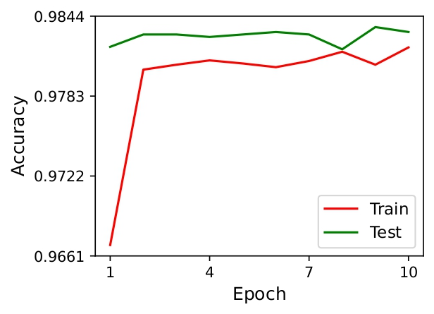
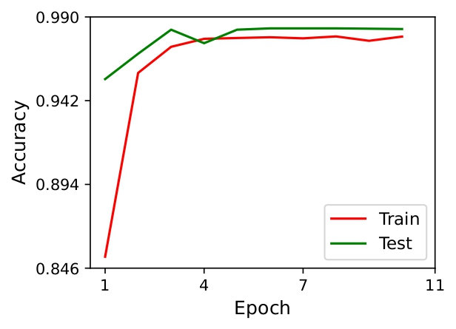
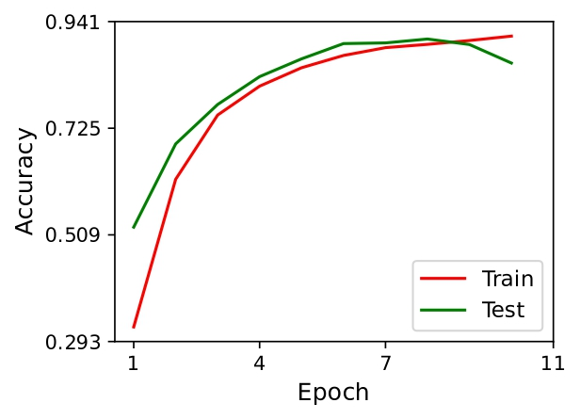
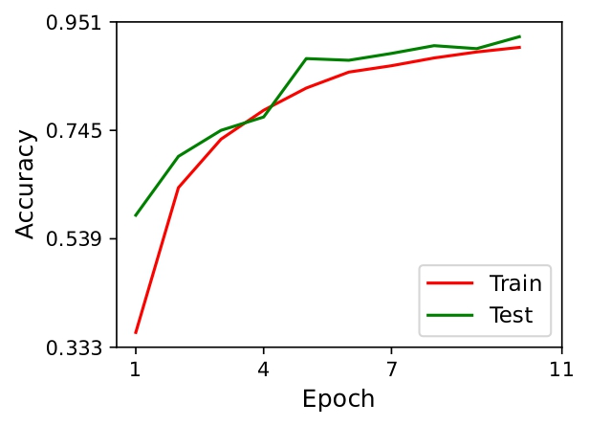
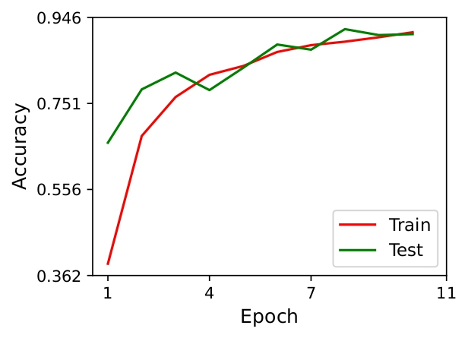
Pre-trained model accuracy
VGG-16
VGG-19
ResNet-50
ResNet-101
ResNet-152

Slide 20
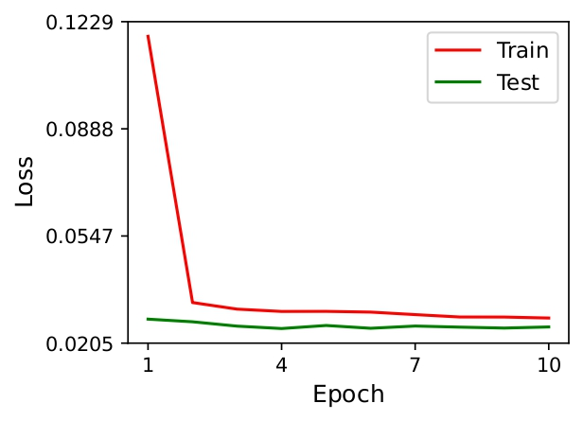
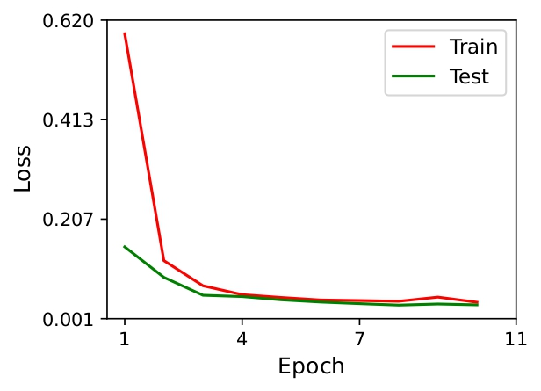
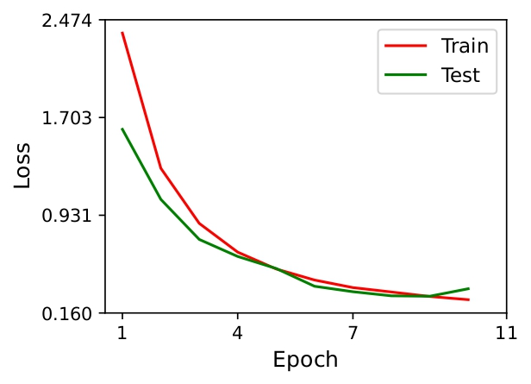
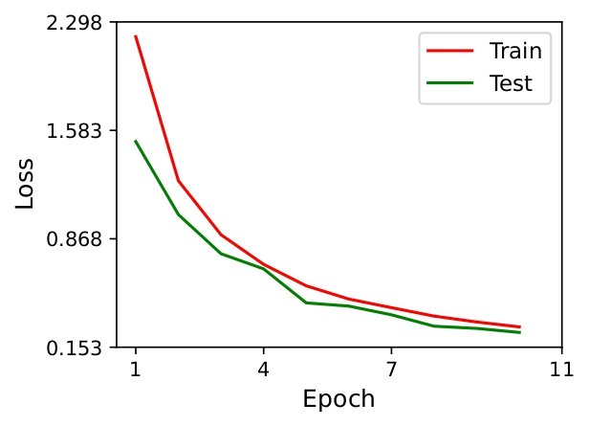
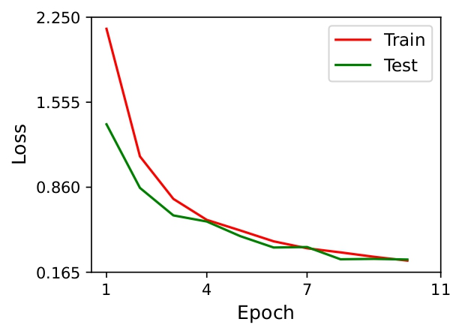
Pre-trained model loss
VGG-16
VGG-19
ResNet-50
ResNet-101
ResNet-152

Slide 21
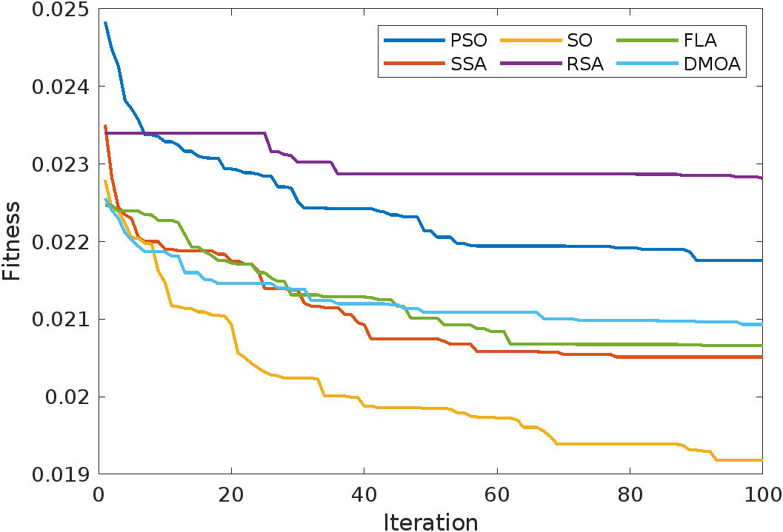
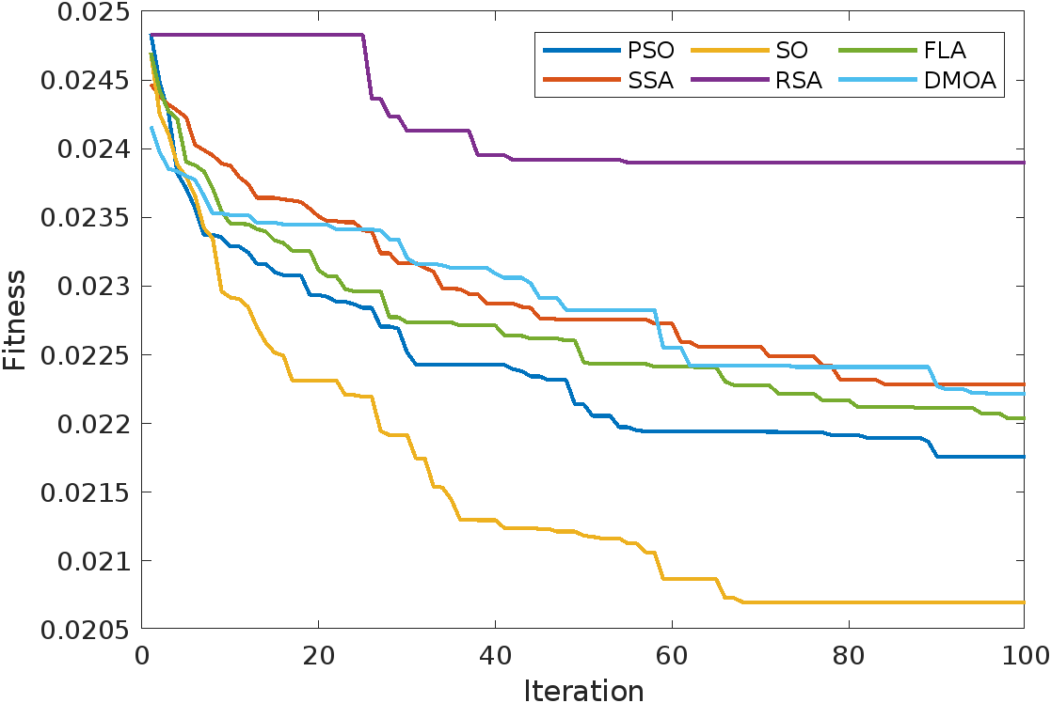
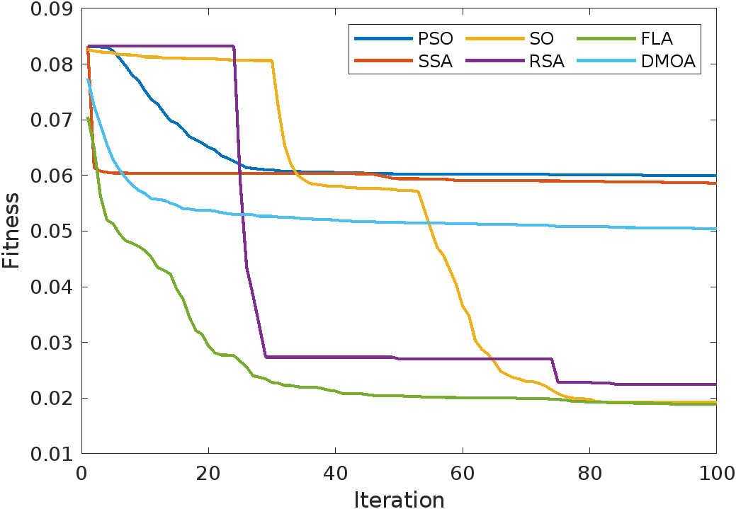
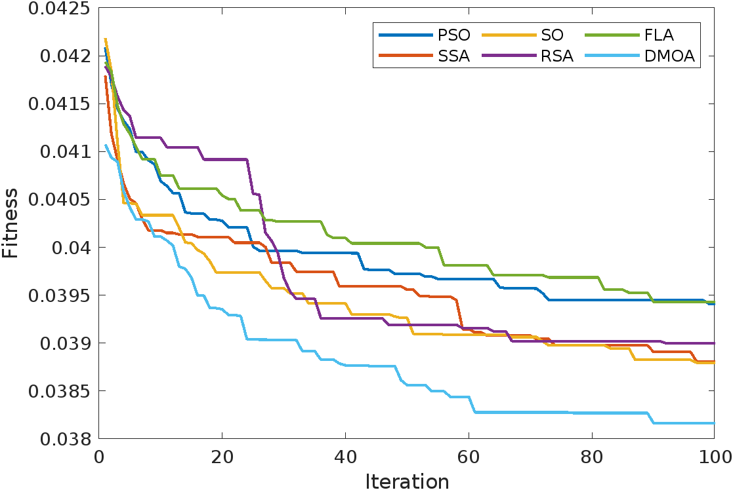
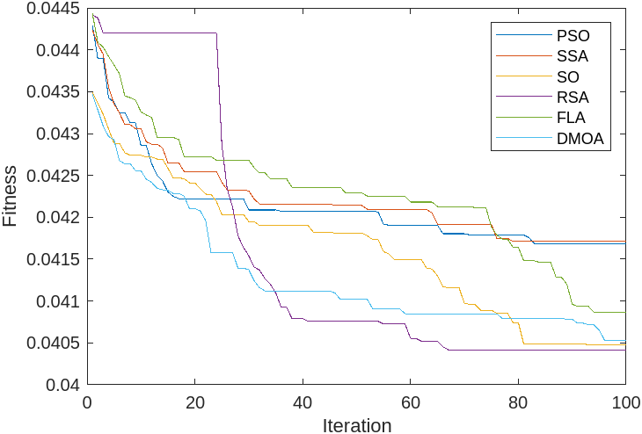
Convergence behaviour of NIA
VGG-16
VGG-19
ReNet-50
ResNet-101
ResNet-152

Slide 22
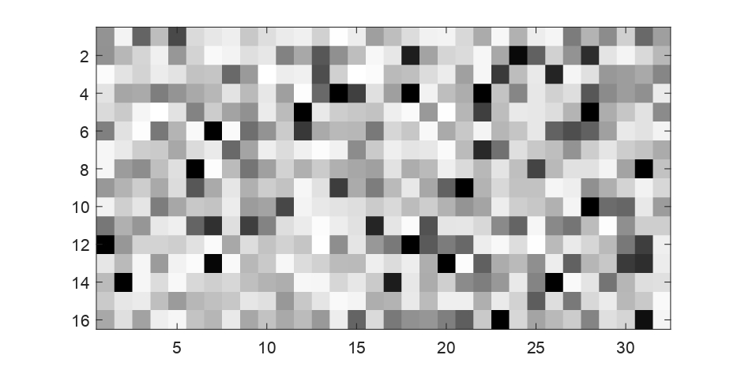
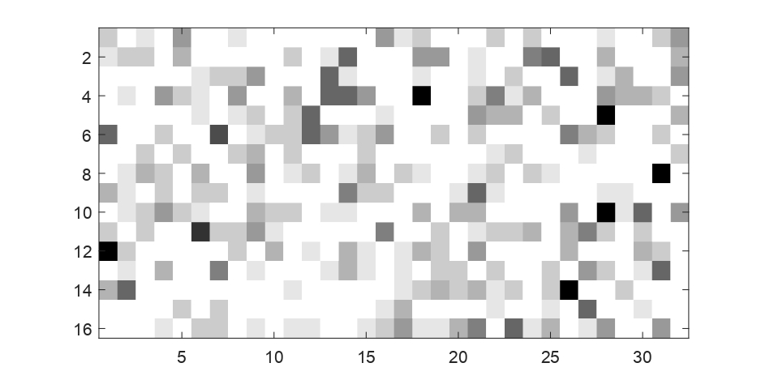
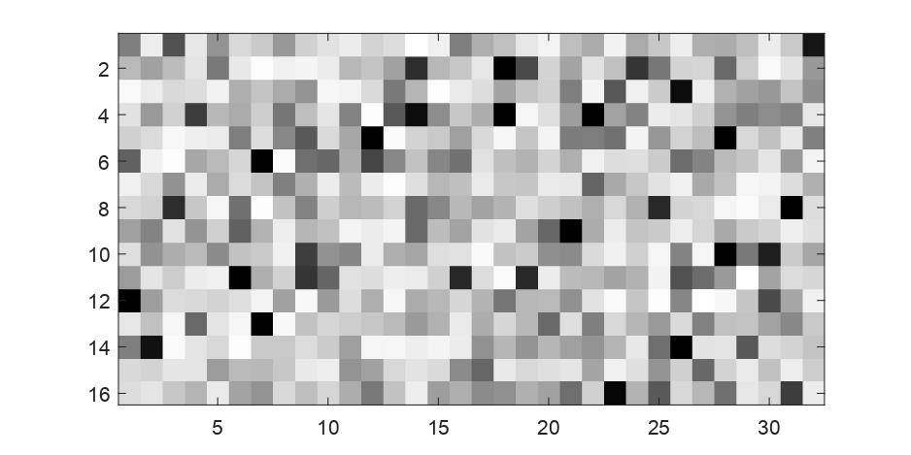
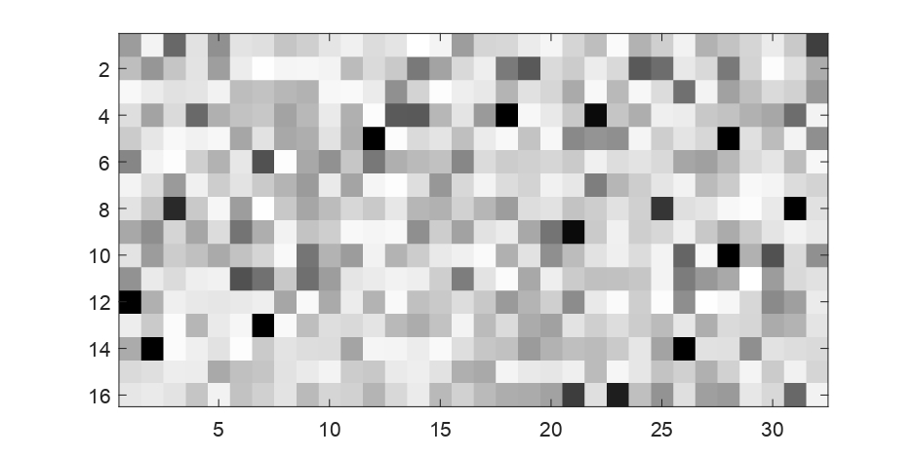
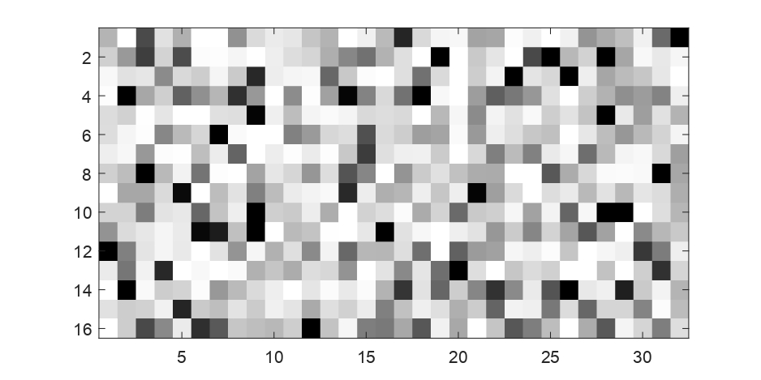
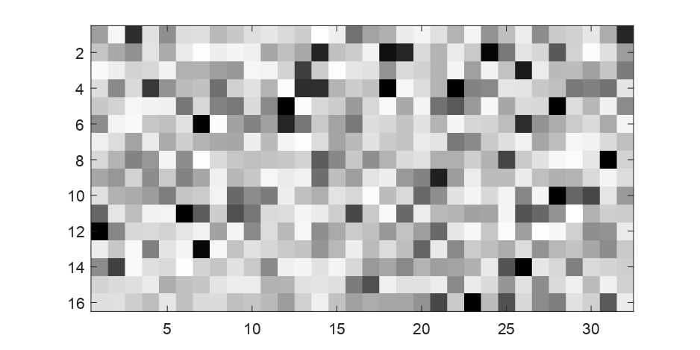
Selection of VGG-16 (16 x 32 = 512) features
PSO
RSA
SSA
SO
DMOA
FLA

Slide 23
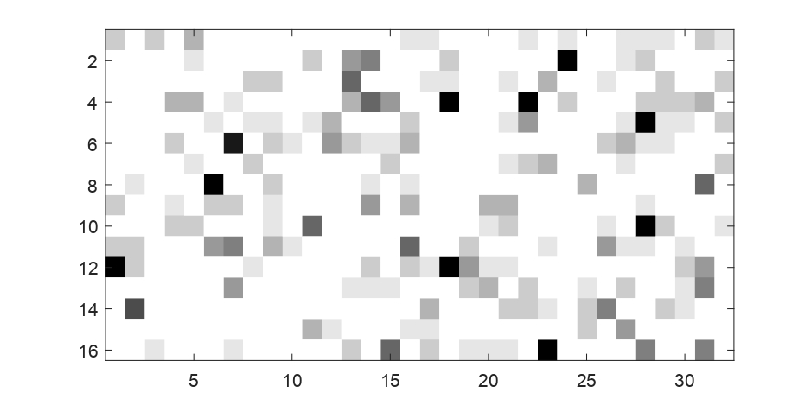
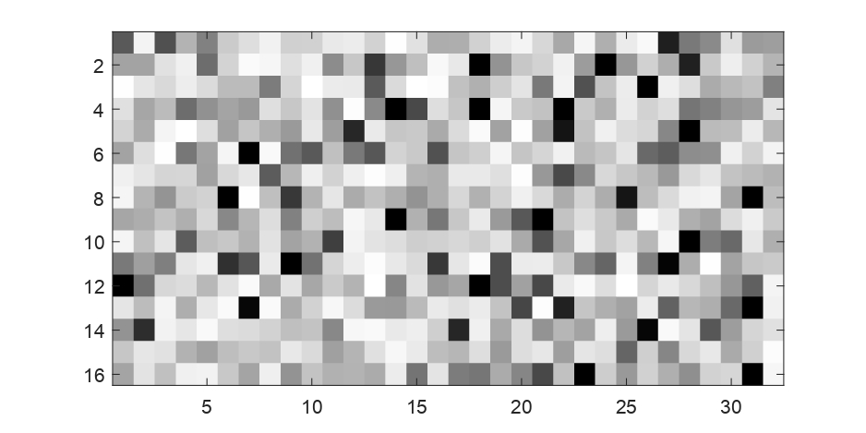
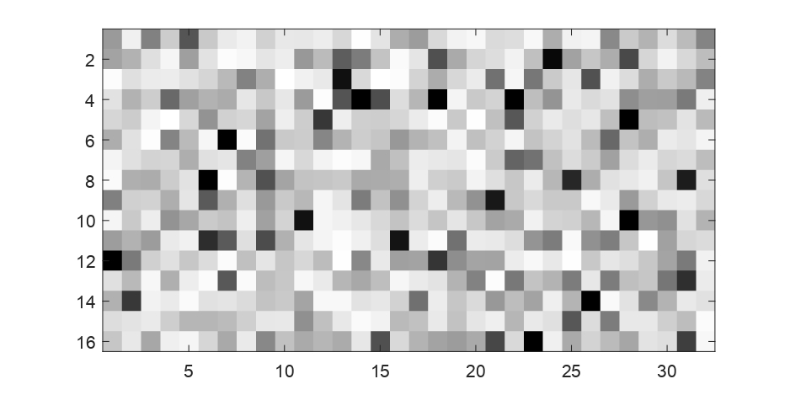
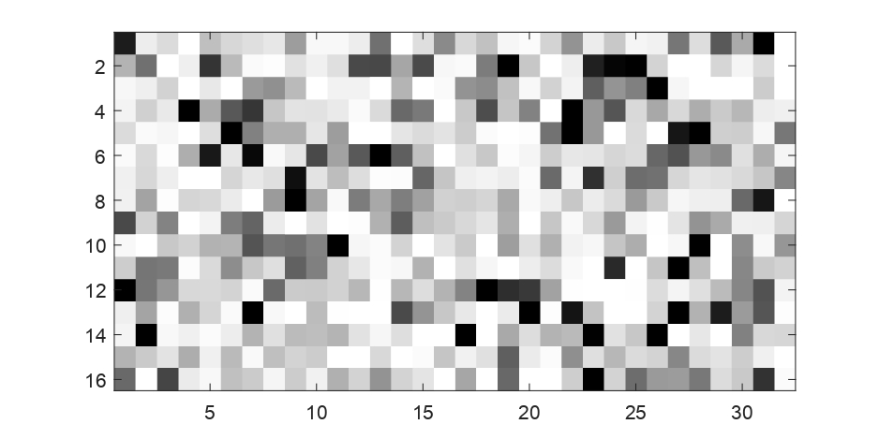
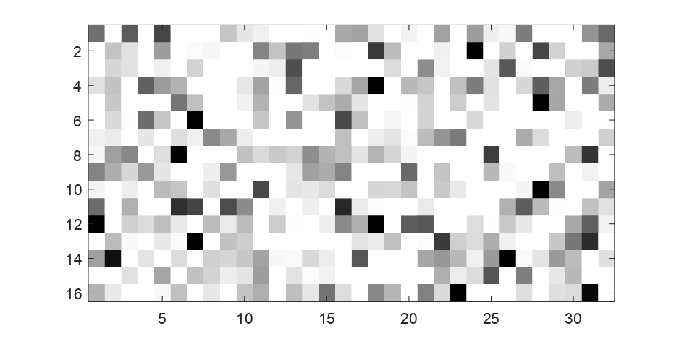
Selection of VGG-19(16 x 32 = 512) Features
PSO
RSA
SSA
SO
DMOA
FLA

Slide 24
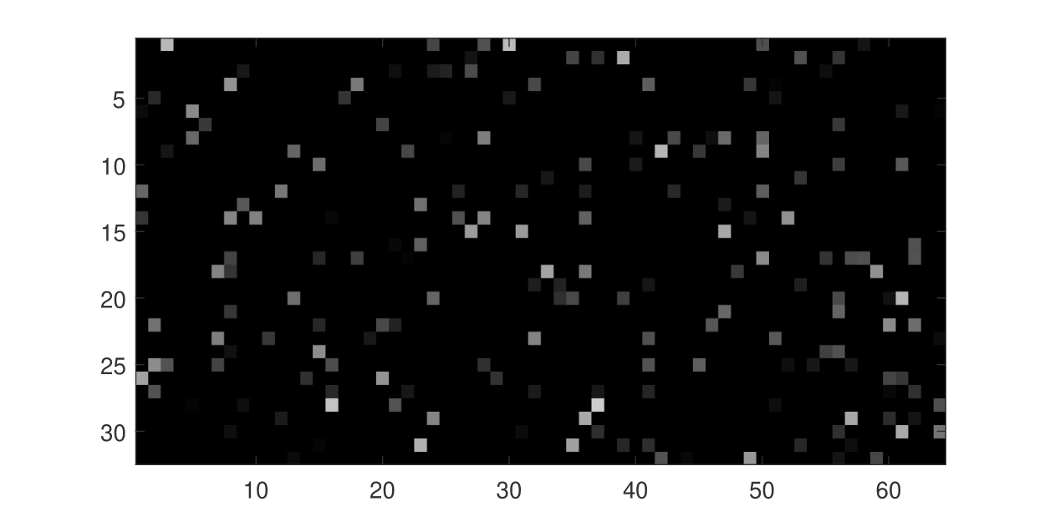
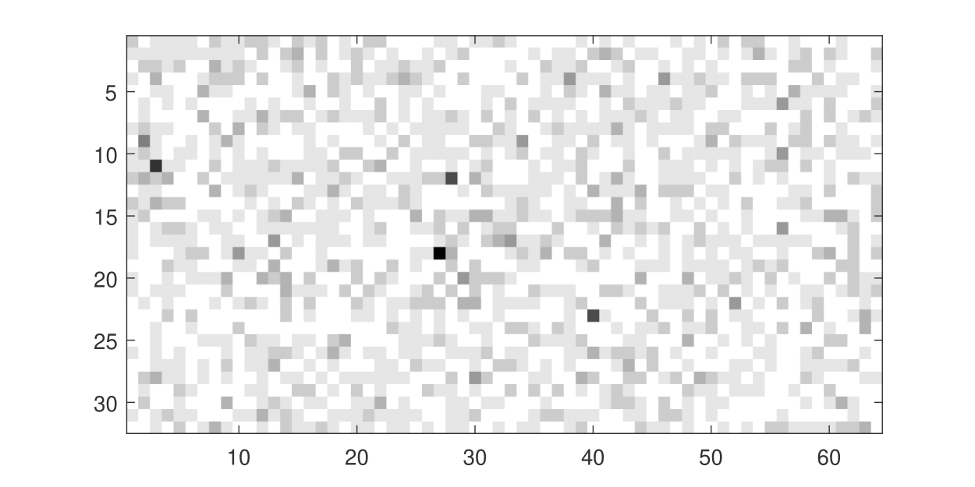
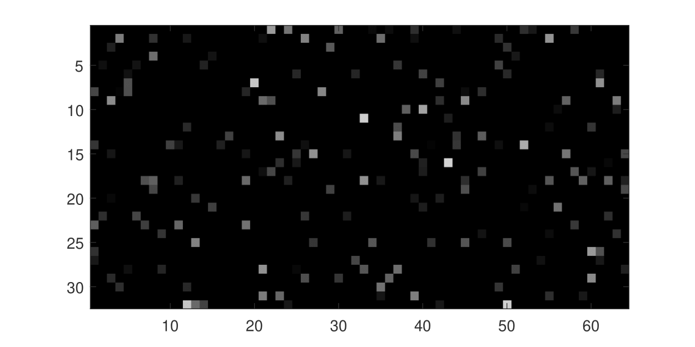
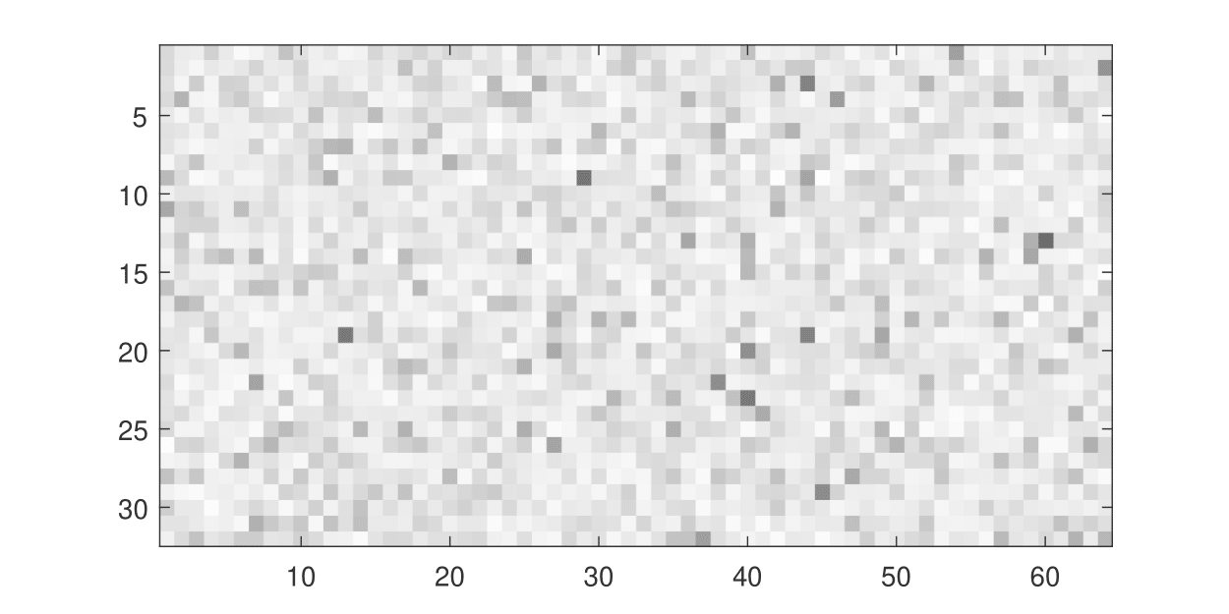
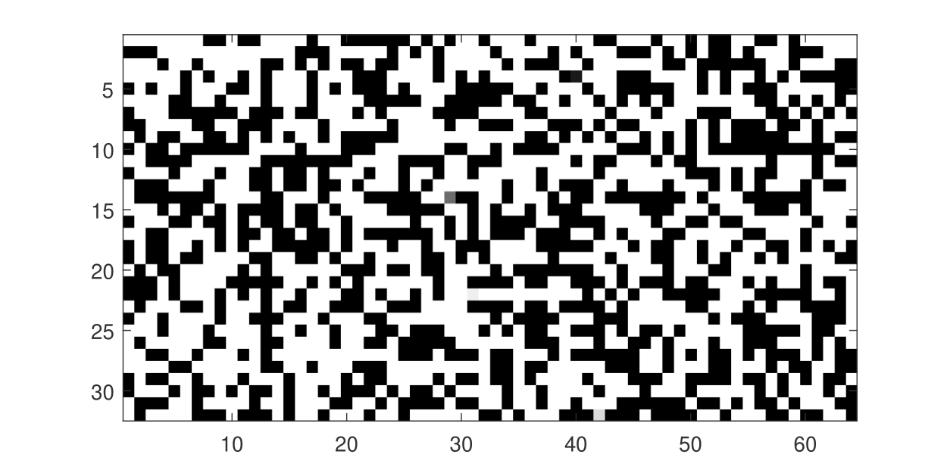
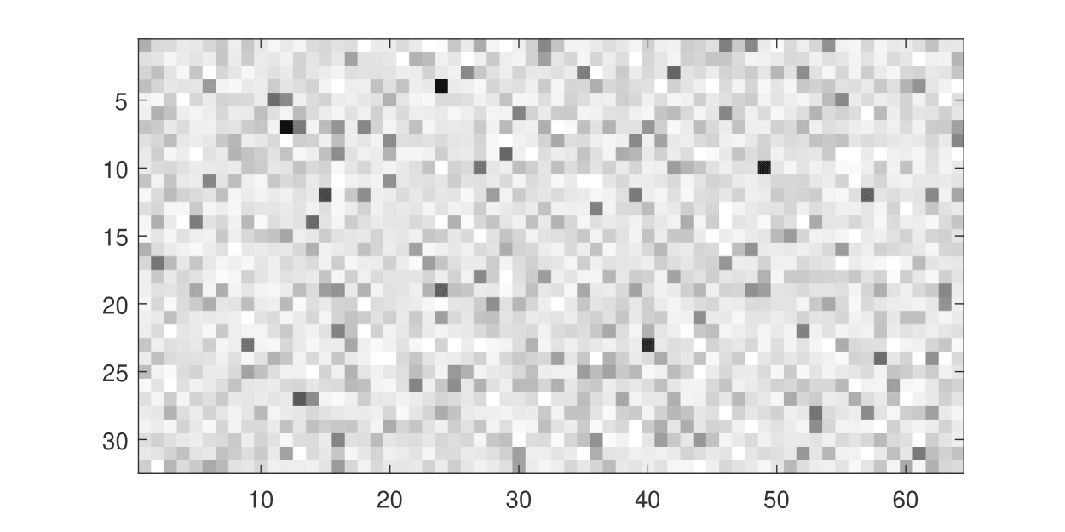
Selection of ResNet-50(32 x 64 = 2048) Features
PSO
RSA
SSA
SO
DMOA
FLA

Slide 25
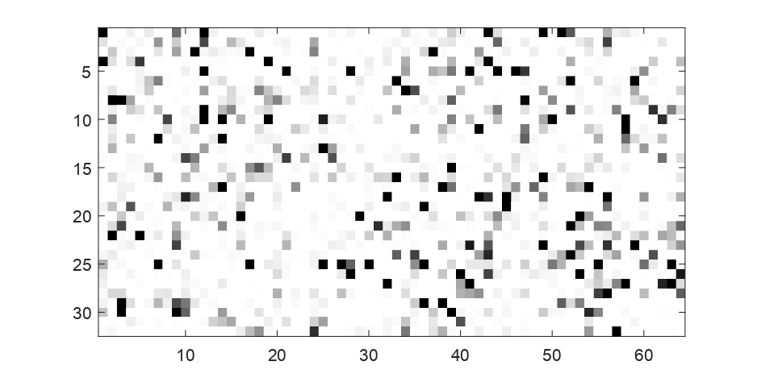
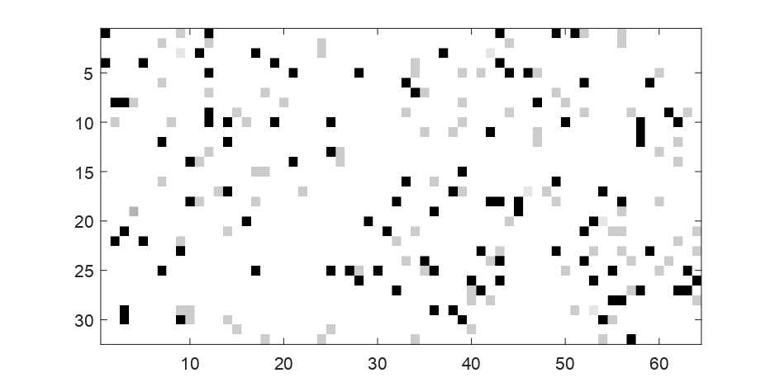


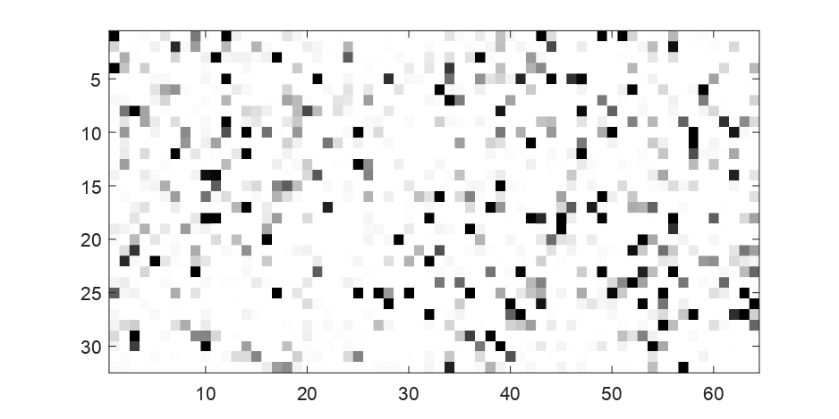
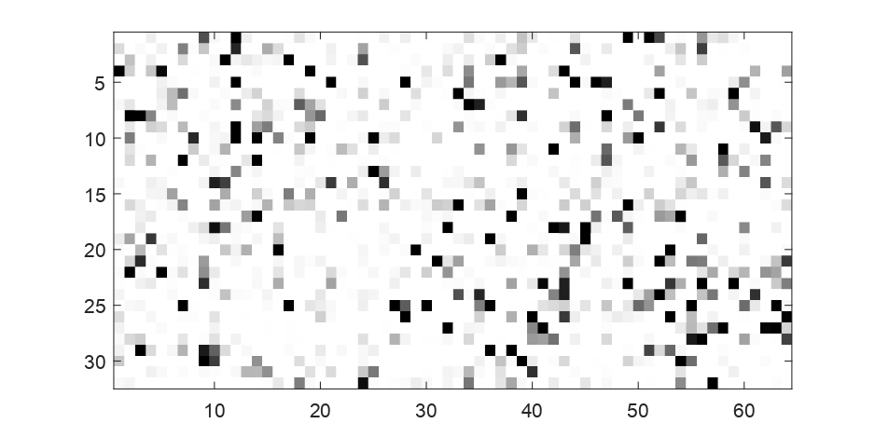
Selection of ResNet-101(32x64=2048) Features
PSO
RSA
SSA
SO
DMOA
FLA

Slide 26
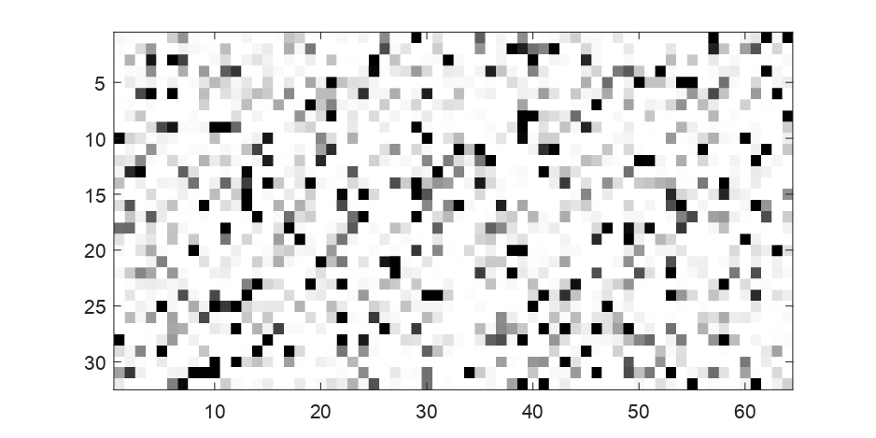
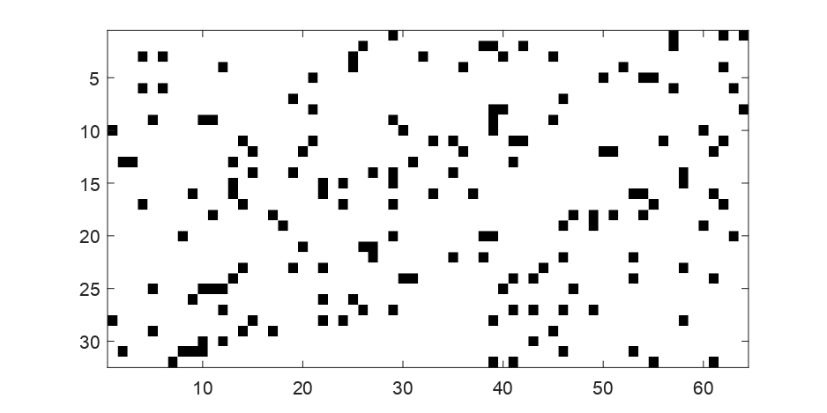

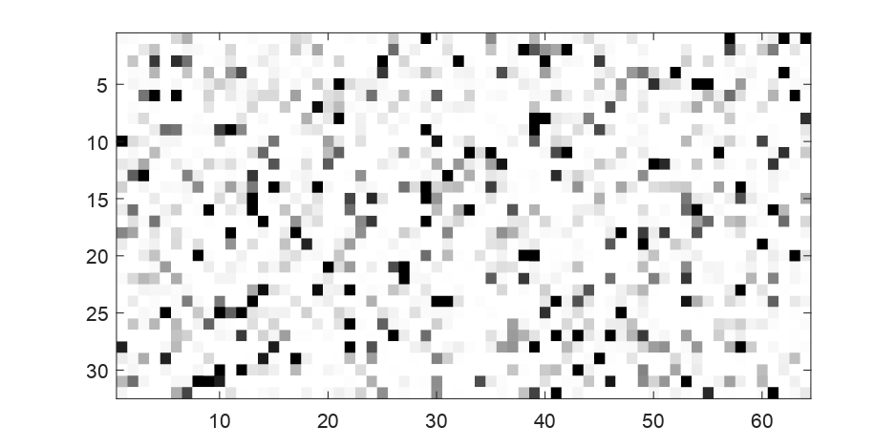
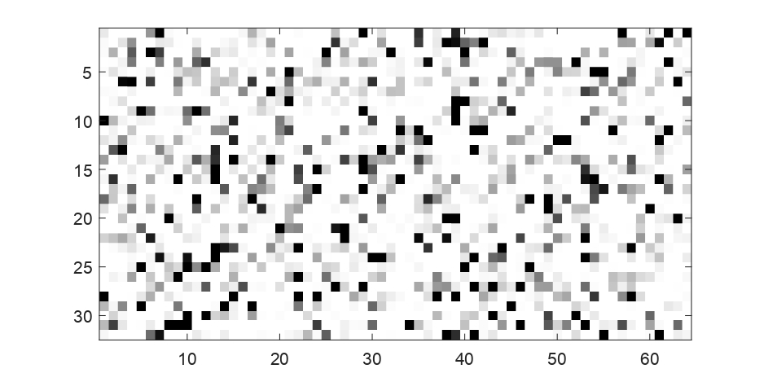
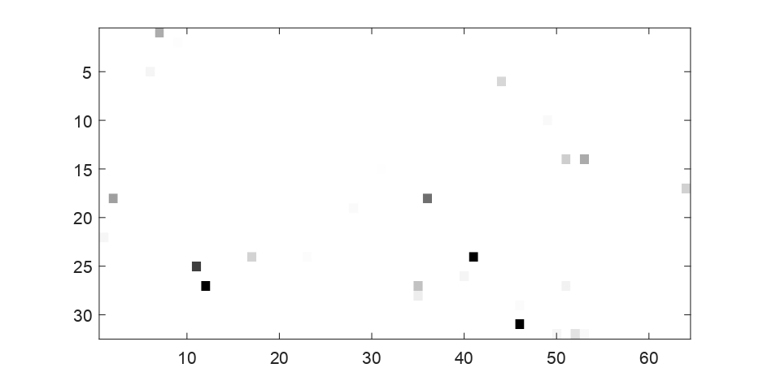
Selection of ResNet-152(32x64=2048) Features
PSO
RSA
SSA
SO
DMOA
FLA

Slide 27
CONCLUSION
Extracted features using VGG-16(512), VGG-19(512), ResNet-50(2048), ResNet-101(2048) & ResNet-152(2048).
Selected Optimized Features using NIA: PSO, SSA, RSA, DMO & SO.
Compared algorithms using quantitative metrics.
FUTURE PLAN
Test on larger & more robust dataset like UOT-100.
Test other NIAs to discover the most appropriate combination.

Slide 28
THANK YOU!!

